Slide 1
Naive Bayes Classification

Slide 2

VALLURUPALLI NAGESWARA RAO VIGNANA JYOTHI INSTITUTE OF ENGINEERING AND TECHNOLOGY
Department of Computer Science and Engineering
Naive Bayes Classification
MACHINE LEARNING
Dr. Kriti Ohri
Assistant Professor
Department of Computer Science and Engineering

Slide 3
What does the term ‘Naive’ in ‘Naive Bayes’ mean ?
The term ‘Naive’ in Naive Bayes comes from the fact that the algorithm considers the features that it is using to make the predictions to be independent of each other, which may not always be the case.
Naive Bayes classifiers are linear classifiers that are known for being simple yet very efficient. The probabilistic model of naive Bayes classifiers is based on Bayes’ theorem, and the adjective naive comes from the assumption that the features in a dataset are mutually independent. In practice, the independence assumption is often violated, but naive Bayes classifiers still tend to perform very well under this unrealistic assumption . Especially for small sample sizes, naive Bayes classifiers can outperform the more powerful alternatives.

Slide 4
Naive Bayes Classification
Naive Bayes is one of the supervised Machine Learning algorithms used for classification problems. This algorithm is based on one of the popular theorems from the probability called Bayes theorem. Naive Bayes is used for the binary as well as multiclass classification problem especially in the field of NLP like document classification, disease diagnosis and so on.

Slide 5
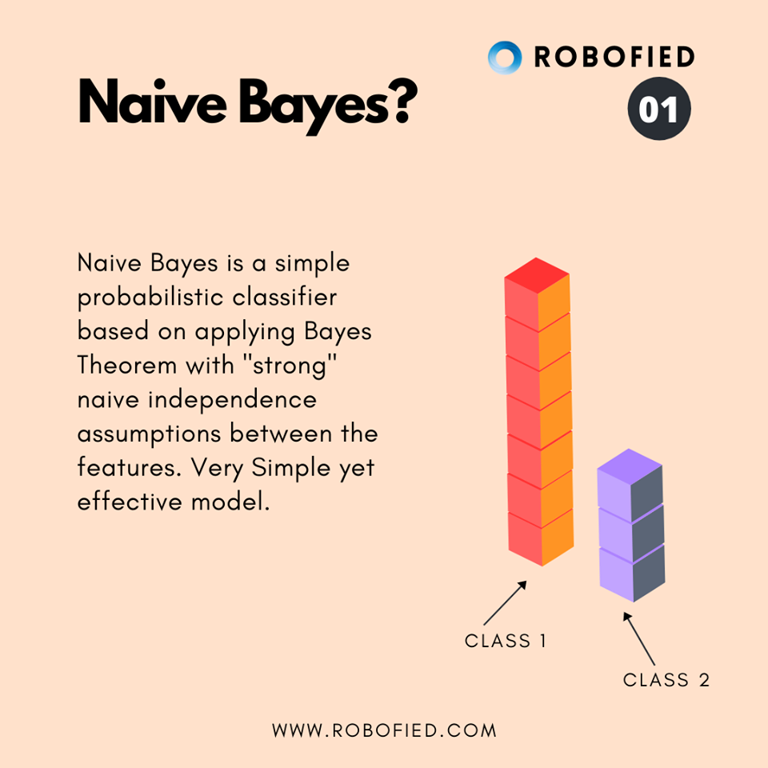

Slide 6
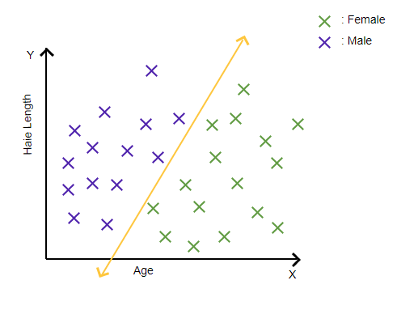
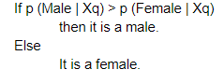
Intuition:
To get a high-level idea of what NB exactly does let’s consider the following example.
Let’s say we want to predict gender (male/female) based on the 2 features i.e. hair length and age. The distribution of 2-D is as follows:
Now the new query point (Xq) arises with 2 new values of a given feature and we want to predict whether it is male or female? How do we do that using Bayes theorem?
Here we calculate the posterior probability for each class and classify a new point (Xq) to a class in which the posterior probability is maximum.

Slide 7
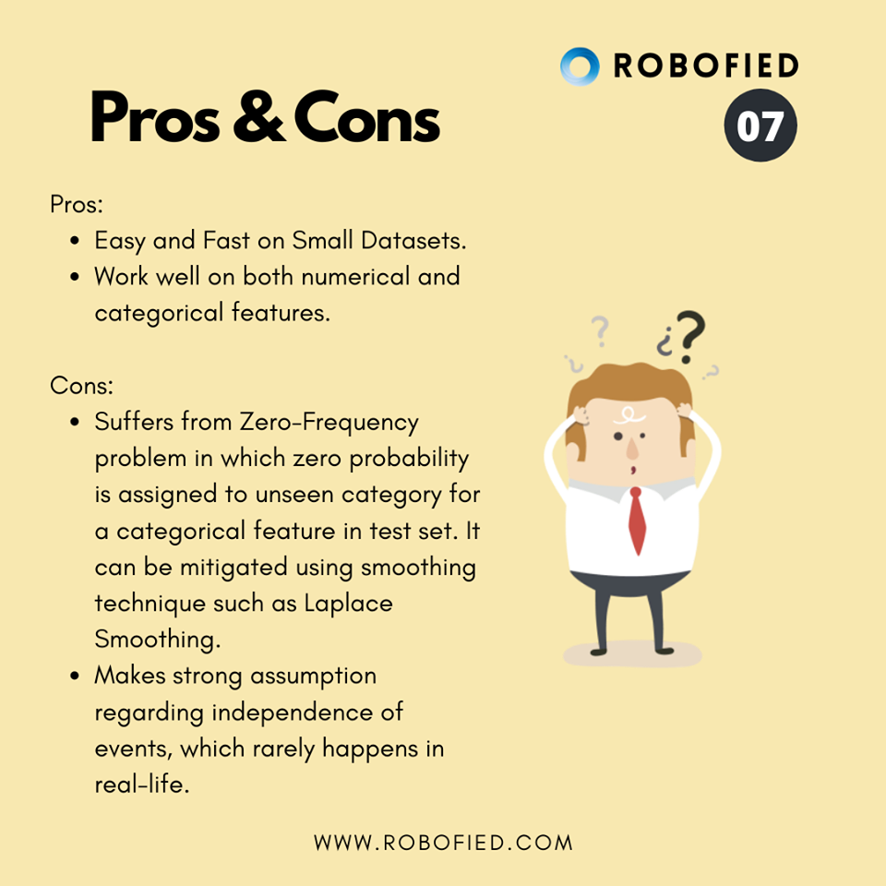

Slide 8
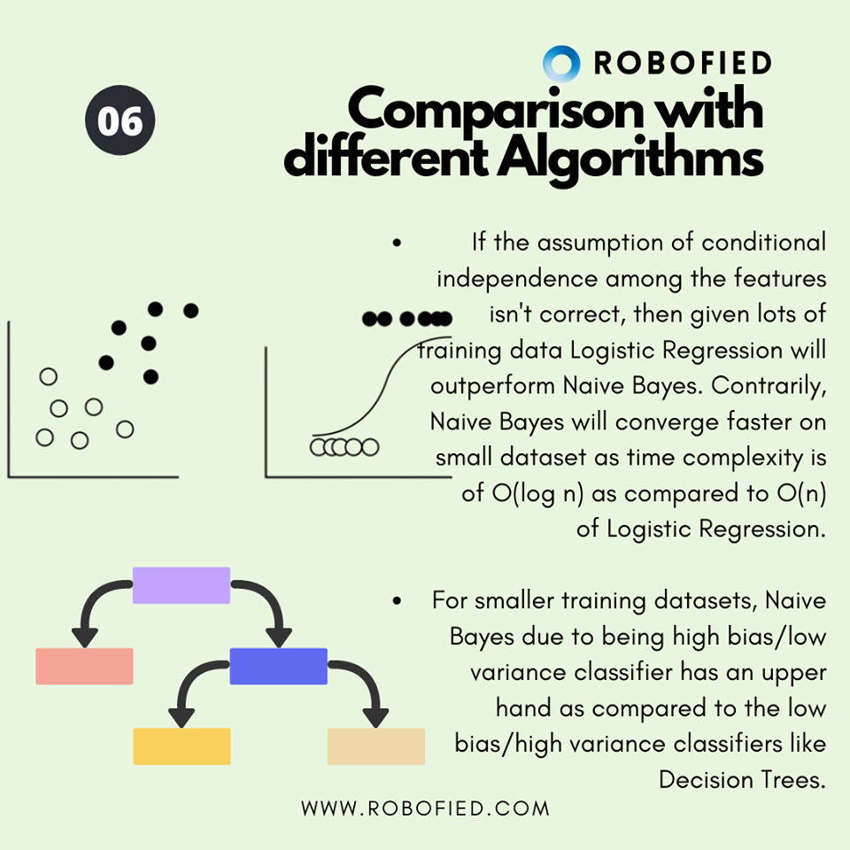

Slide 9
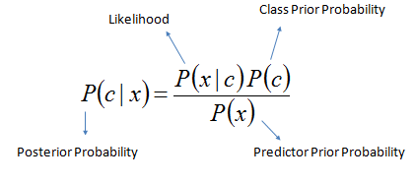
Bayes theorem:
With Bayes theorem, we can find the probability of c (class) given that x has already occurred. Here, x is the evidence for hypothesis A. The equation for it is given below:

Slide 10
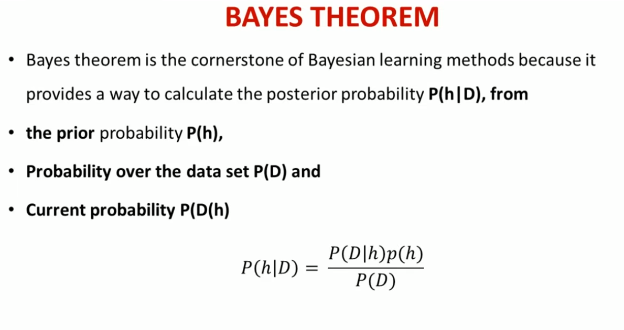
or marginal probability
Or likelihood
Hypothesis space H
h1
h1
input
output
h 3
h2
h2
h 3

Slide 11
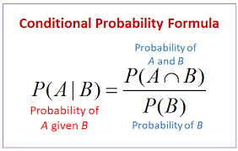
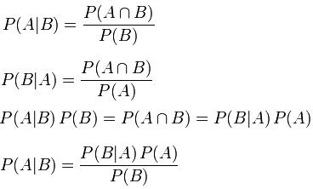
Naïve Bayes is based on Naïve theorem, which is based on conditional probability
Bayes theorem

Slide 12
So, Bayes theorem deals with how to find the probability of a hypothesis given the data.
you have different possible competing hypothesis and you can find out the probability of the individual hypothesis given the data, so that you can find out which is the most probable or most likely hypothesis according to the Bayes theorem probability.
Probability of hypothesis given data (Posterior probability) is given by p(D|h) times prior probability of the hypothesis p(h) divided by P(D).
So, P(h )is the prior probability of the hypothesis h.
Prior probability, in Bayesian statistical inference, is the probability of an event before new data is collected. This is the best rational assessment of the probability of an outcome based on the current knowledge before an experiment is performed.
Probability D given h is the probability of the data. If the hypothesis is true, what is the likelihood of that data being generated? If h was true what is the probability of D being generated (liklihhod) and P(D) is the likelihood of the data. So, based on this, we have Bayes theorem.

Slide 13
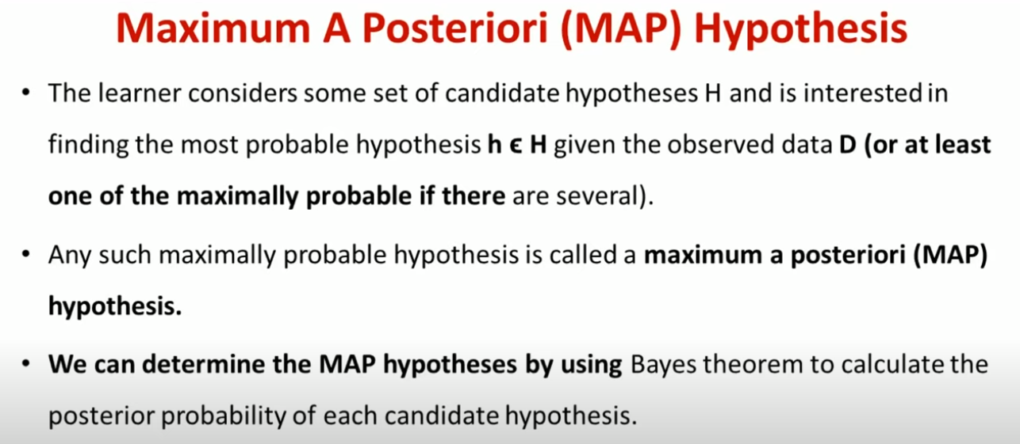
h1
input
output
h2
h 3
Out of h1,h2,h3 which is most probable

Slide 14
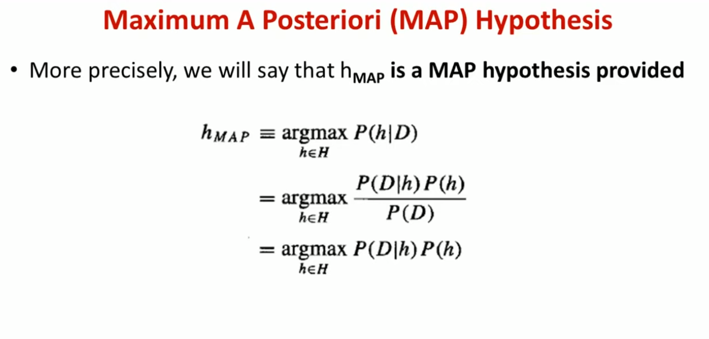
Posterior probability
h1
input
output
h2
Out of h1,h2,h3 which is most probable is called Maximum A Posteriori hypothesis
h 3

Slide 15
Bayes theorem can be used to find maximum A posteriori hypothesis.
So, based on the Bayes theorem, we can find out the most likely hypothesis /probable hypothesis which is called the maximum posterior hypothesis.
So, a maximum A posteriori hypothesis is one which has p(h|D) as maximum
P(d) is independent of a particular hypothesis. We can ignore it
Now, in the event if for all hypotheses, the probability is equal, then you choose that hypothesis for which p(D|h) is maximum

Slide 16
Argmax is an operation that finds the argument that gives the maximum value from a target function. Argmax is most commonly used in machine learning for finding the class with the largest predicted probability. Argmax can be implemented manually, although the argmax() NumPy function is preferred in practice.

Slide 17
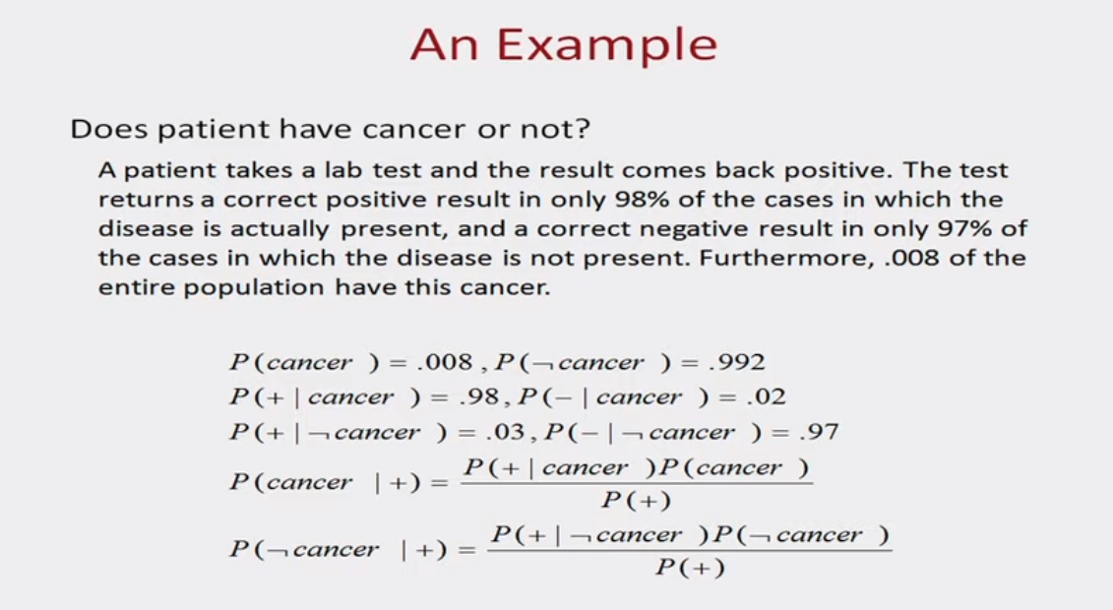
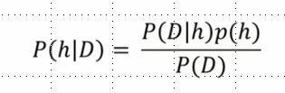

Slide 18
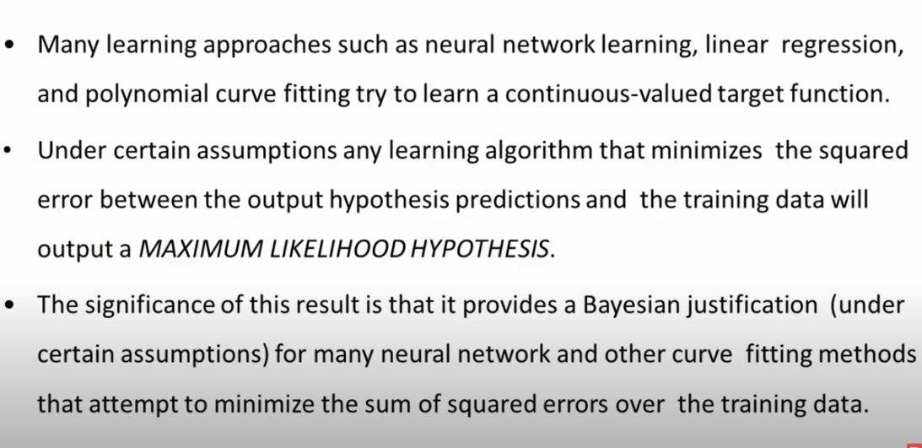
Maximum Likelihood Hypothesis

Slide 19
Assumptions of NB:
The adjective naive for Naive Bayes comes from the assumption that the features in the dataset are iid i.e. independent and identically distributed. Because of this assumption, the classifier is called Naive.
So this one of the biggest assumptions of NB that says that the presence of one particular feature does not affect the other which is quite not possible in real-world data.

Slide 20
Naïve Bayes is based on Naïve theorem, which is based on conditional probability
Bayes theorem

Slide 21
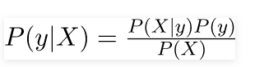
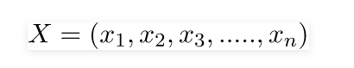
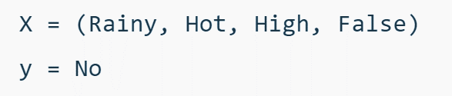
Now, with regards to our dataset, we can apply Bayes’ theorem in following way:
Class conditional probability
Class Prior Probability or class probability
Posterior Probability
Prior Predictor Probability and it will be same for all classes
where, y is class variable and X is a dependent feature vector (of size n) where:
Just to clear, an example of a feature vector and corresponding class variable can be: (refer 1st row of d
ataset)
So basically, P(y|X) here means, the probability of “Not playing golf” given that the weather conditions are “Rainy outlook”, “Temperature is hot”, “high humidity” and “no wind”

Slide 22
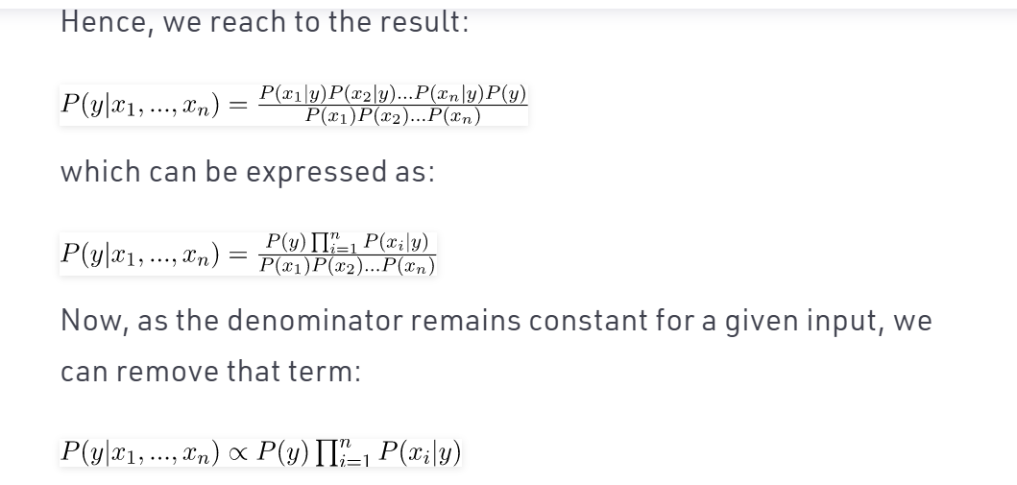

Slide 23
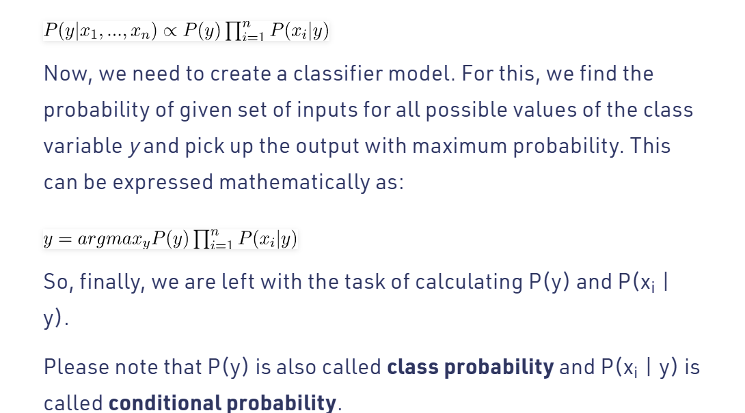

Slide 24
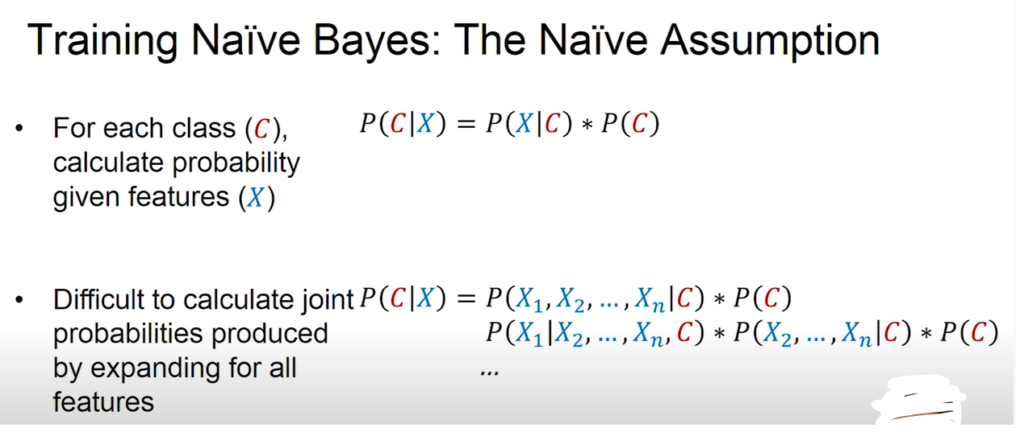
Steps:
For each class calculate probability given features (X)
Difficult to calculate joint probability P(C|X) produced by expanding for all features.
So for this we make the assumption of features independence.

Slide 25
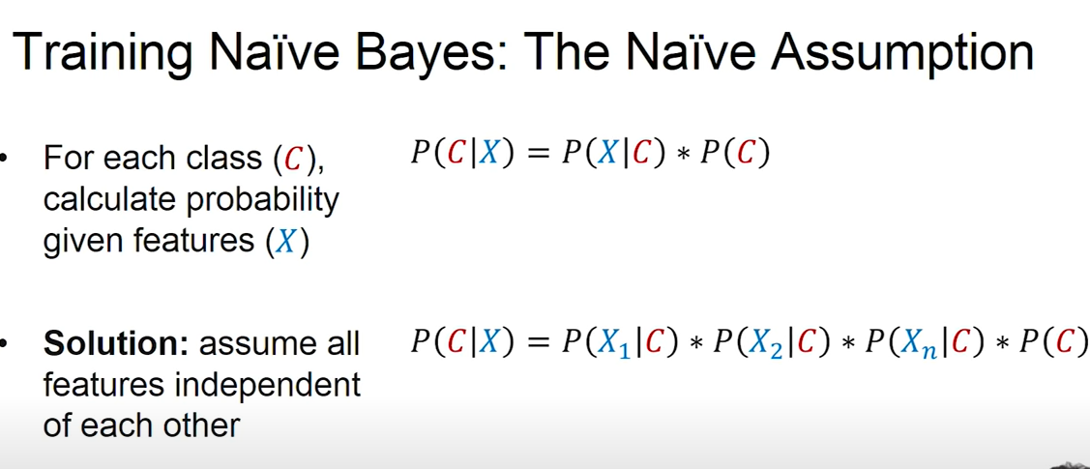

Slide 26
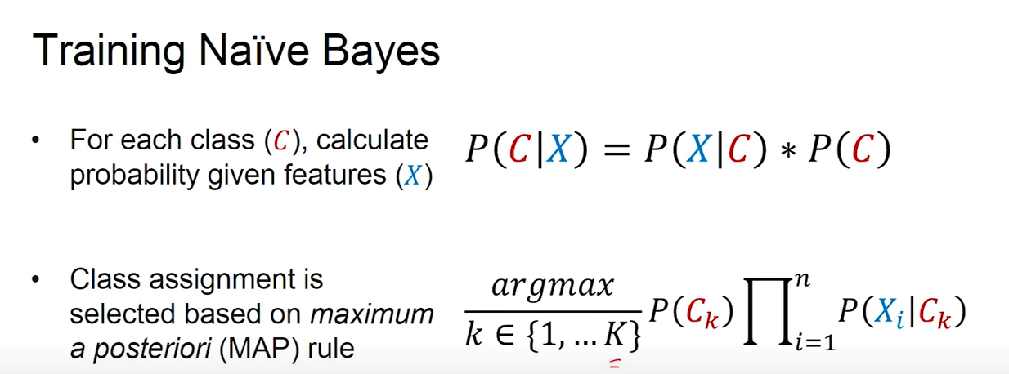

Slide 27
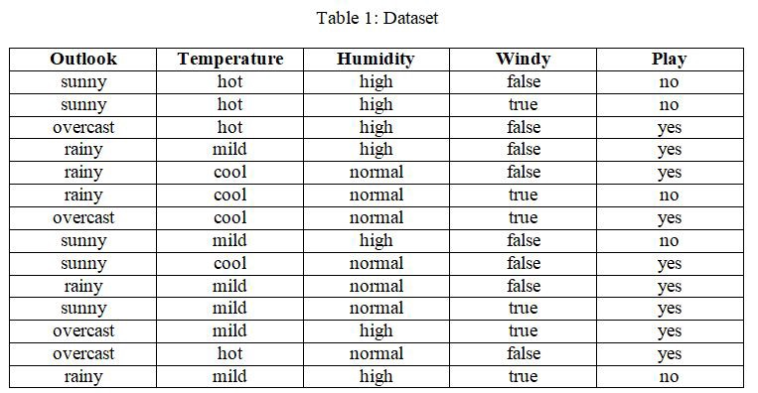
Problem

Slide 28
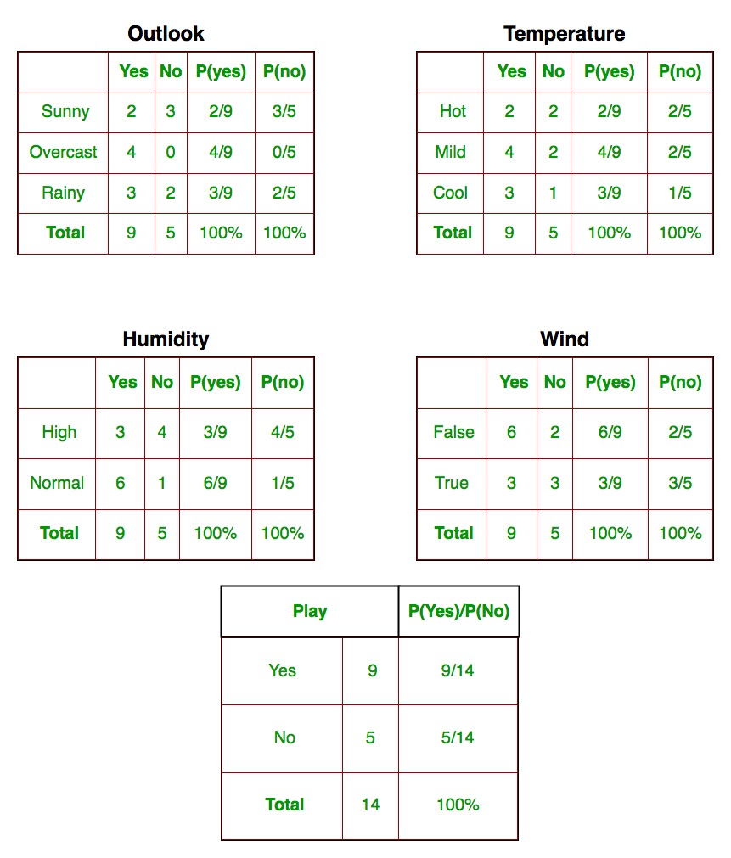
Probability of sunny given yes
Probability of sunny given NO
These tables are called probability lookup tables based on training data
Notes:
We work with these data and calculate conditional probabilities just by doing frequency of occurance

Slide 29
So, in the figure above, we have calculated P(x_{i} | y_{j}) for each x_{i} in X and y_{j} in y manually in the tables 1-4. For example, probability of playing golf given that the temperature is cool, i.e P(temp. = cool | play golf = Yes) = 3/9.
Also, we need to find class probabilities (P(y)) which has been calculated in the table 5. For example, P(play golf = Yes) = 9/14.

Slide 30
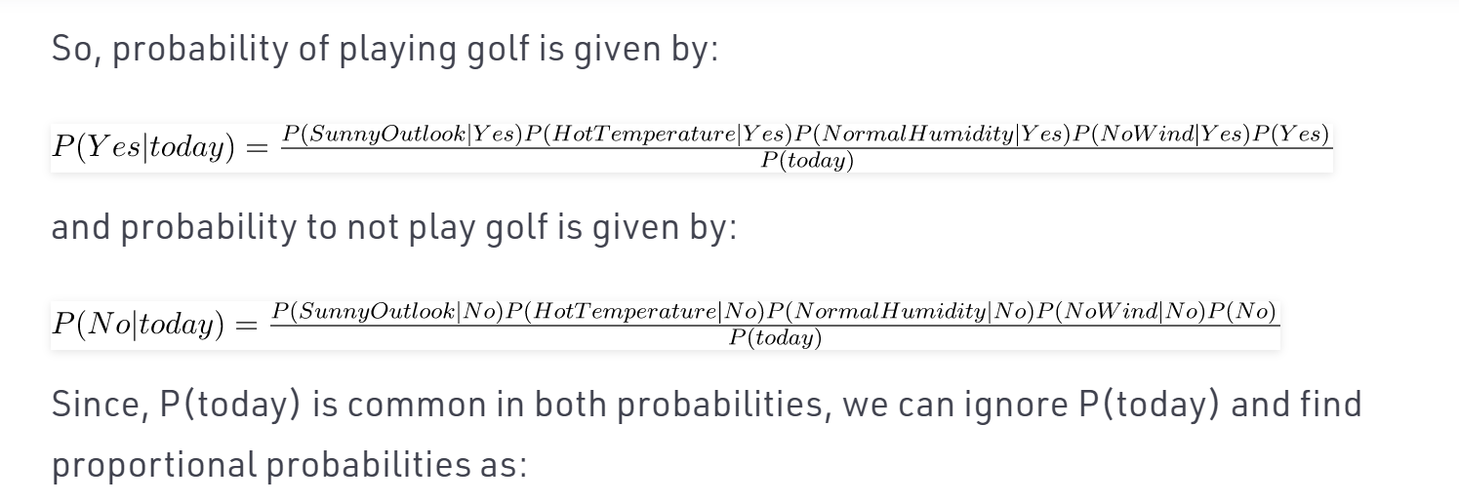
, predict if golf will be played or not??
So, probability of playing golf is given by:

Slide 31
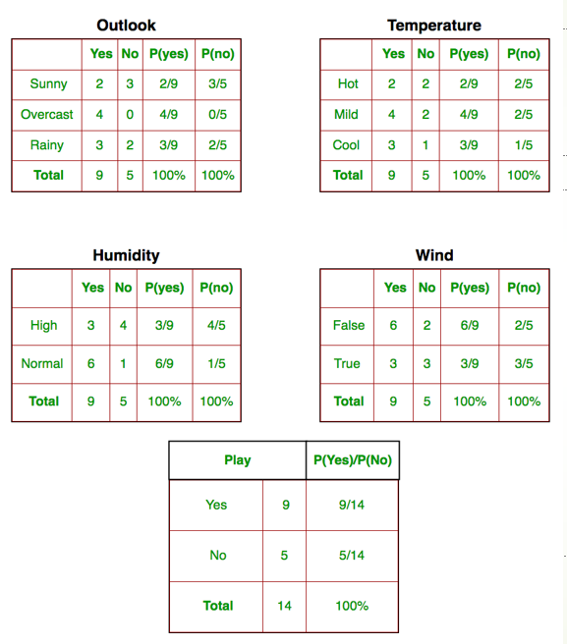
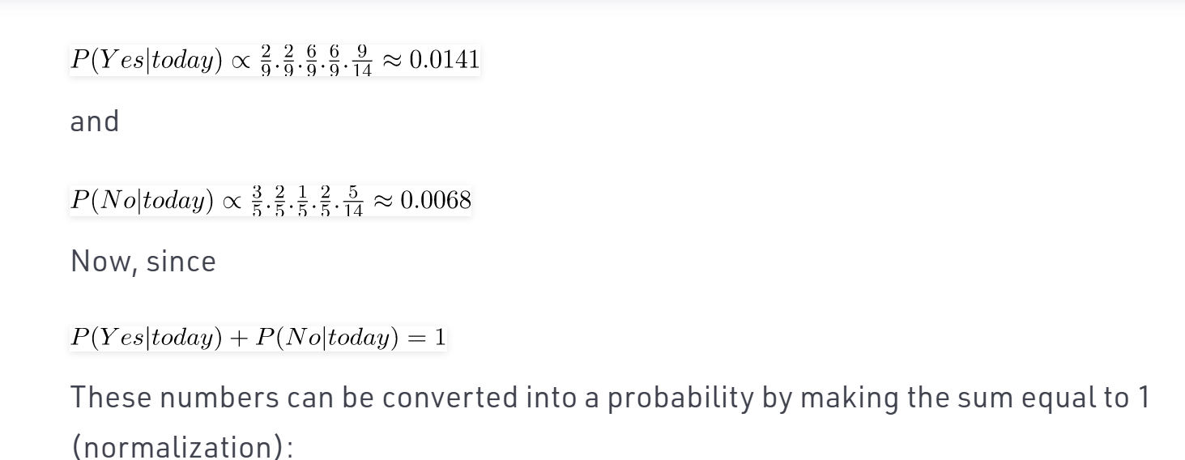

Slide 32
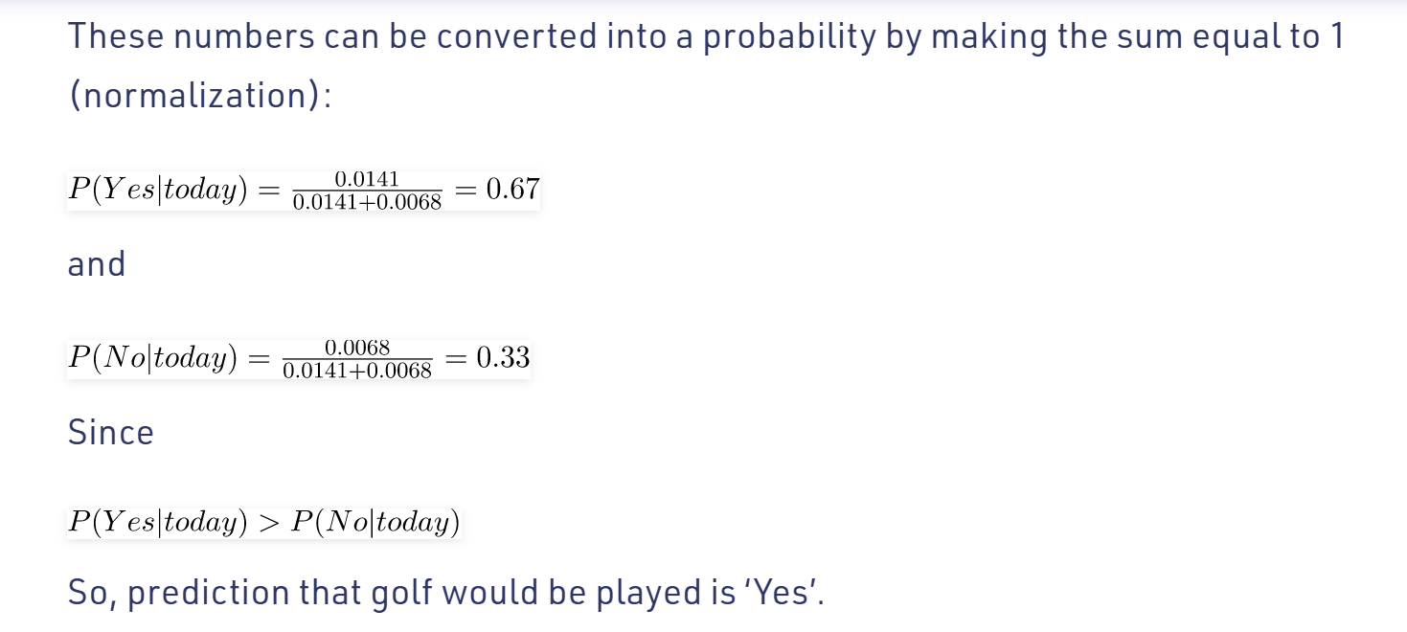

Slide 33
Laplace Estimate
When the probability for attribute type is 0, overall result is zero. Therefore contribution by other attributes gets wasted.
To overcome this we use smoothing operation i.e. laplace Estimate to avoid zero probability.
Solve the numerical
https://www.youtube.com/watch?v=SHdBunw7Fok
Laplace smoothing | Laplace Correction | Zero Probability in Naive Bayes Classifier by Mahesh Huddar (youtube.com)

Slide 34
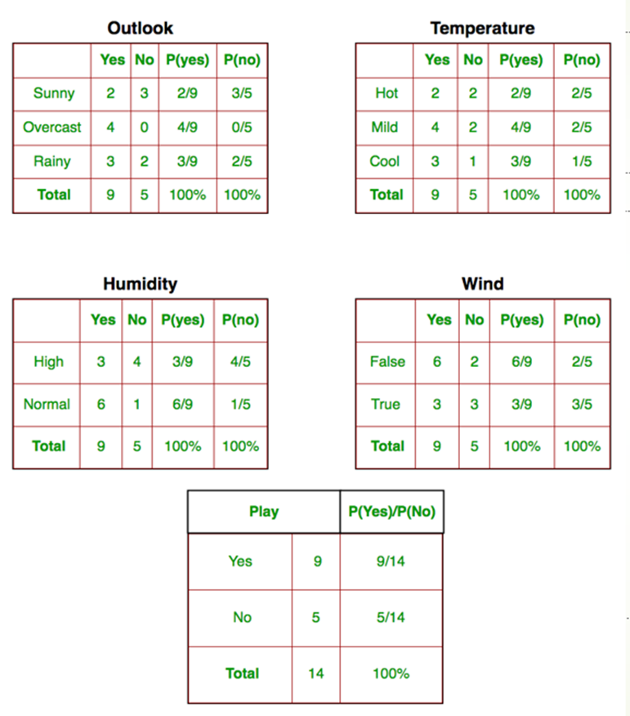
the probability for attribute type is 0

Slide 35
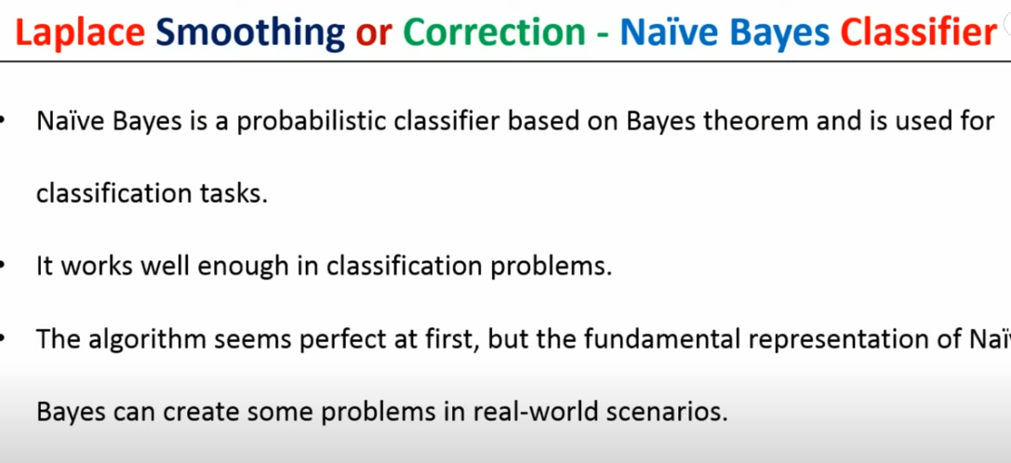

Slide 36
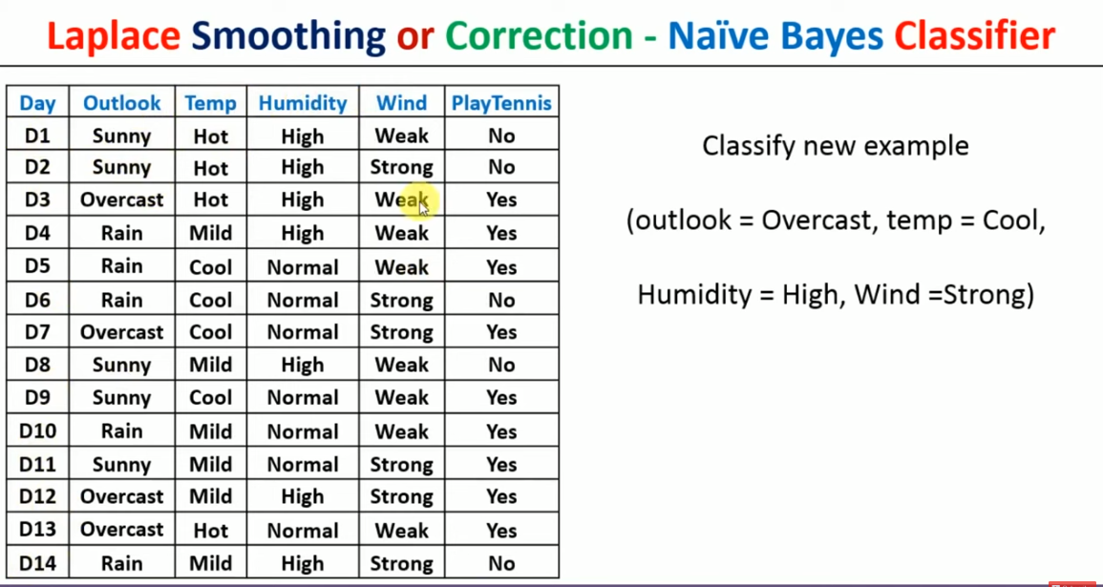

Slide 37
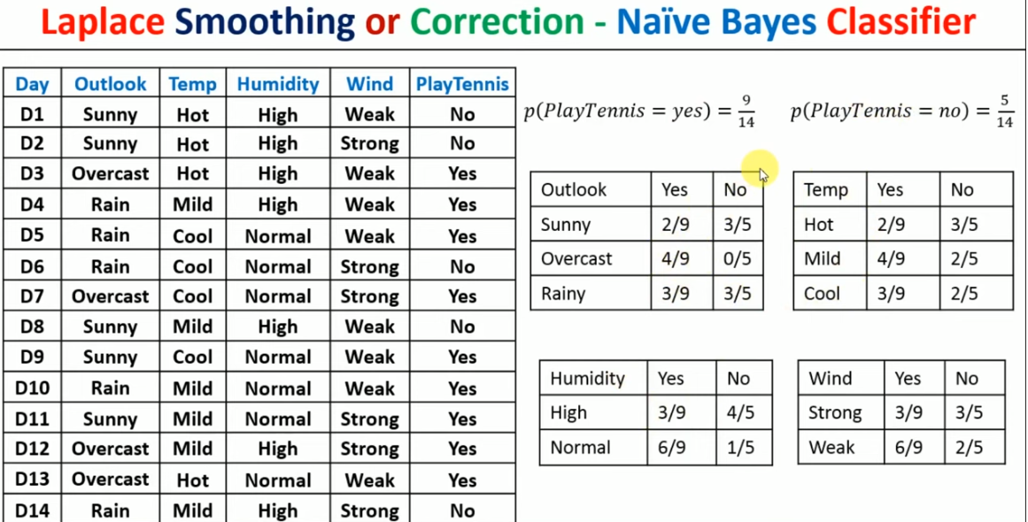

Slide 38
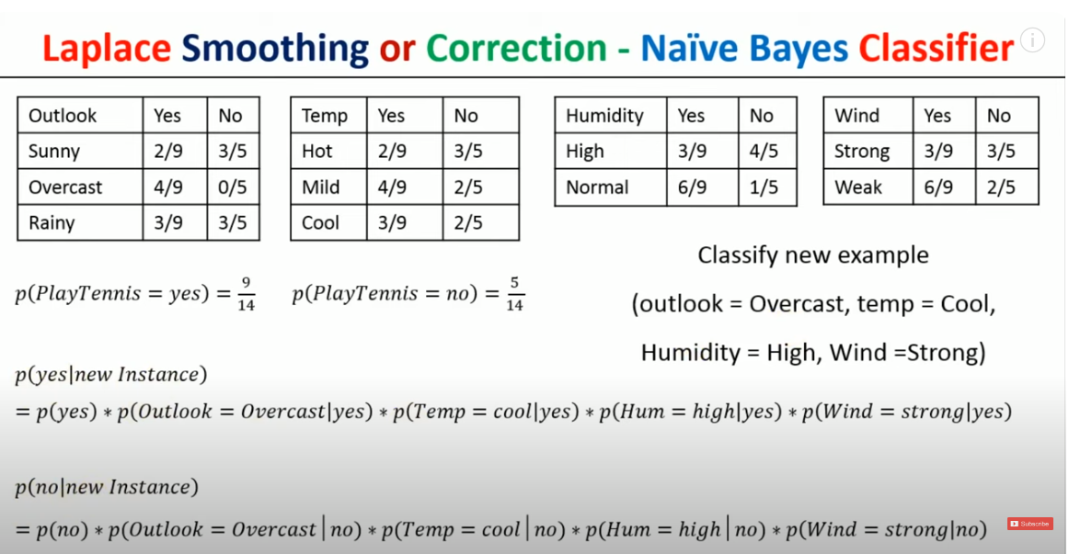

Slide 39
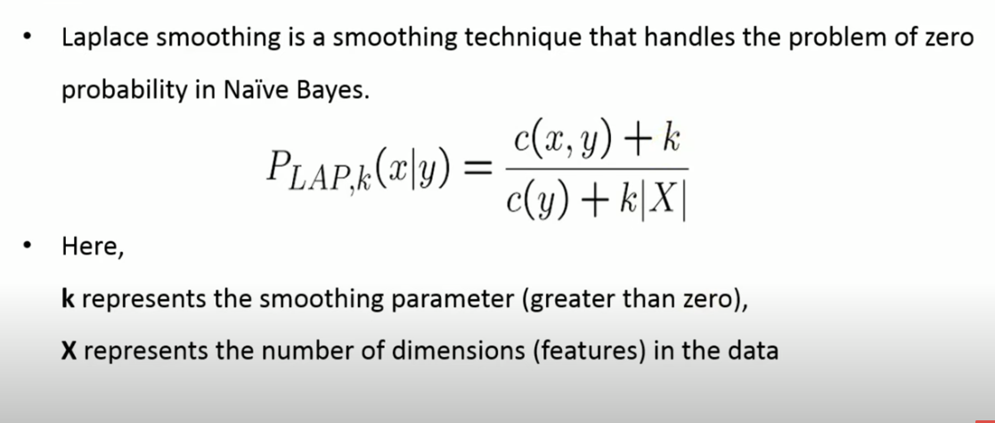
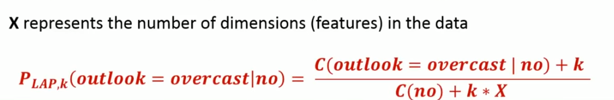
Laplace Estimation
Count: c(x,y) the number of times x appear in y examples
Smoothing parameter
Number of y examples

Slide 40
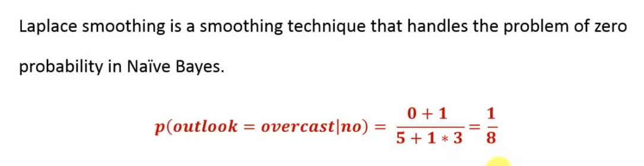

Slide 41
Advantages:
Easy to implement.
Fast
If the independence assumption holds, then it works more efficiently than other algorithms.
It requires less training data.
It is highly scalable.
It can make probabilistic predictions.
Can handle both continuous and discrete data.
It can work easily with missing values.
Easy to update on the arrival of new data.
Best suited for text classification problems.

Slide 42
Disadvantages:
The strong assumption about the features to be independent is hardly true in real-life applications.
Chances of loss of accuracy.
Zero Frequency, i.e. if the category of any categorical variable is not seen in the training data set, then the model assigns a zero probability to that category, and then a prediction cannot be made.

Slide 43
Applications of Naïve Bayes
Real-time Prediction: Naive Bayes Algorithm is fast and always ready to learn hence best suited for real-time predictions.
Multi-class Prediction: The probability of multi-classes of any target variable can be predicted using a Naive Bayes algorithm.
Recommendation system: Naive Bayes classifier with the help of Collaborative Filtering builds a Recommendation System. This system uses data mining and machine learning techniques to filter the information which is not seen before and then predict whether a user would appreciate a given resource or not.
Text Classification/ Sentiment Analysis/ Spam Filtering: Due to its better performance with multi-class problems and its independence rule, the Naive Bayes algorithm performs better or has a higher success rate in text classification; therefore, it is used in Sentiment Analysis and Spam filtering.

Slide 44
Types of Naïve Bayes
Bernoulli Naive Bayes - Used for discrete data, where features are only in binary form.
Multinomial Naive Bayes - Widely used classifier for document classification which keeps the count of frequent words present in the documents.
Gaussian Naive Bayes - Used when we are dealing with continuous data and uses Gaussian distribution..

Slide 45
Bernoulli naive Bayes
Bernoulli Naive Bayes (BNB) is another variant of the Naive Bayes classifier. It is designed for binary/boolean data, where features are either 1 (true/present) or 0 (false/absent). Bernoulli Naive Bayes is well-suited for text classification tasks where the presence or absence of a word in a document is important (e.g., whether a word appears in a document or not).
Key Assumptions:
Naive assumption: Features are conditionally independent given the class.
Bernoulli distribution: The features are binary (0 or 1), representing the absence or presence of a feature.

Slide 46
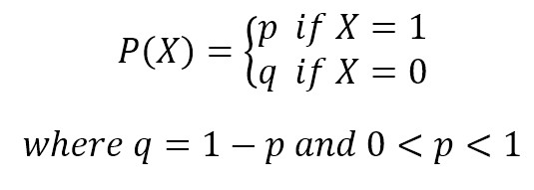
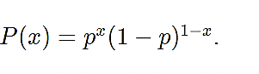
Bernoulli naive Bayes
If X is random variable Bernoulli-distributed, it can assume only two values (for simplicity, let’s call them 0 and 1) and their probability is:

Slide 47
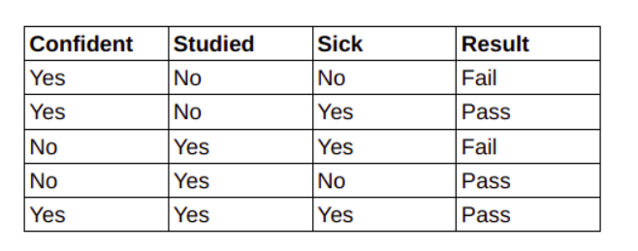
Example
If your dataset has binary features, 1, 0 or, yes no, or success and failure,

Slide 48
Examples of Bernoulli trials:
Coin tosses: Record how many tosses of coins resulted in heads and how many coin tosses resulted in tails. We can consider the result of getting heads as success and not getting head i.e., getting tails to be a failure.
Football: How many shots on a goal post resulted in the goal score, and how many shots were missed. We can call a goal scored as a “success” and a missed target to be a failure.
Rolling Dice: The probability of a roll of two dice resulting in a double six. A double six dice roll could be considered to be a success and everything else can be considered a failure.

Slide 49
Properties of a Bernoulli distribution:
There are only two possible outcomes a 1 or 0, i.e., success or failure in each trial.
The probability values of mutually exclusive events that encompass all the possible outcomes need to sum up to one.
If the probability of success is p then the probability of failure is given as 1-p. The probability values must remain the same across each successive trial. Each event must be completely separate and have nothing to do with the previous event. i.e., the probabilities are not affected by the outcomes of other trials which means the trials are independent.

Slide 50
Applications of Bernoulli Outcomes
There are real-life situations that involve noting if a specific event occurs or not. Such events are recorded as a success or a failure. E.g. Some of the examples that explain binary outcome scenarios involve calculating the probability of-
Success of a medical treatment
Interviewed person being a female
Student result(Pass/fail) in an exam
Transmittance of a disease (transmitted/not transmitted)
The Bernoulli distribution finds application in above cases as well as number of other situations that are similar to above cases.

Slide 51
Advantages of Bernoulli Naive Bayes:
They are extremely fast as compared to other classification models
As in Bernoulli Naive Bayes each feature is treated independently with binary values only, it explicitly gives penalty to the model for non-occurrence of any of the features which are necessary for predicting the output y. And the other multinomial variant of Naive Bayes ignores this features instead of penalizing.
In case of small amount of data or small documents(for example in text classification), Bernoulli Naive Bayes gives more accurate and precise results as compared to other models.
It is fast and are able to make to make real-time predictions
It can handle irrelevant features nicely
Results are self explanatory

Slide 52
Disdvantages of Bernoulli Naive Bayes:
Being a naive(showing a lack of experience) classifier, it sometimes makes a strong assumption based on the shape of data
If at times the features are dependent on each other then Naive Bayes assumptions can affect the prediction and accuracy of the model and is sensitive to the given input data
If there is a categorial variable which is not present in training dataset, it results in zero frequency problem. This problem can be easily solved by Laplace estimation.

Slide 53
Multinomial Naïve Bayes
Multinomial Naive Bayes (MNB) is a type of Naive Bayes classifier that's particularly suited for classification with discrete feature vectors, such as word counts or term frequencies in text classification tasks. Unlike Gaussian Naive Bayes, which assumes a Gaussian distribution, MNB is based on a multinomial distribution, making it a great choice for text data or categorical features.
Key Assumptions:
Naive assumption: The features are conditionally independent given the class.
Multinomial distribution: Features represent counts (like word occurrences) and follow a multinomial distribution.

Slide 54
Multinomial Naïve Bayes
Multinomial Naïve Bayes: Feature vectors represent the frequencies with which certain events have been generated by a multinomial distribution. This is the event model typically used for document classification.
MultinomialNB implements the naive Bayes algorithm for multinomially distributed data, and is one of the two classic naive Bayes variants used in text classification (where the data are typically represented as word vector counts
It is mostly used in text classification problems.

Slide 55
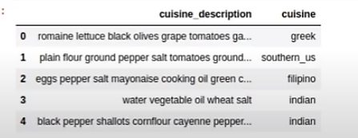

Slide 56
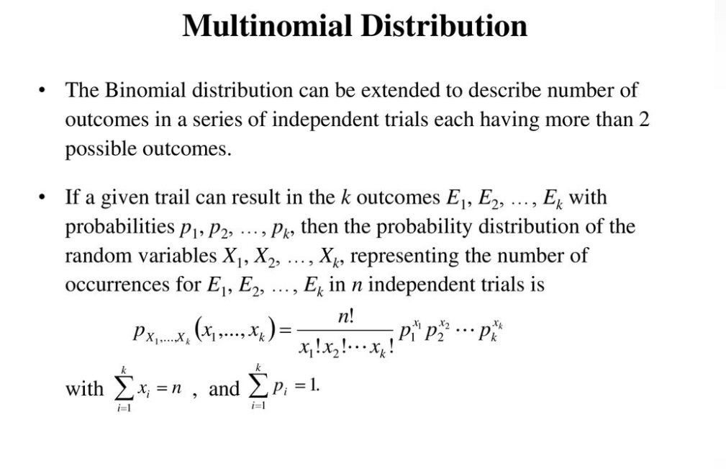

Slide 57
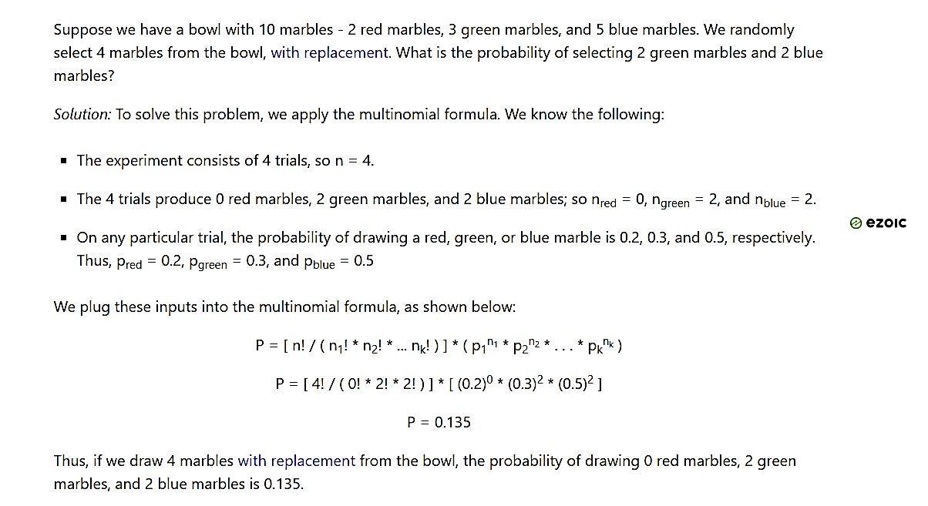

Slide 58
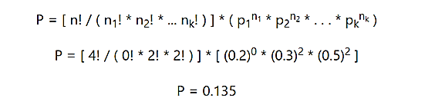
10 marbles
2
red
3
green
5
blue
Randomly select 4 balls from it, i.e no. of trails is n or 4
P(n1=0, n2=2, n3=2) ???
Marble | Red marble | Green marble | Blue marble
Probability | 0.2 | 0.3 | 0.5

Slide 59
Application of multinomial naïve bayes
Multinomial Naive Bayes is widely used in text classification, such as spam detection, sentiment analysis, and document classification, where the features are typically word counts or term frequencies.

Slide 60
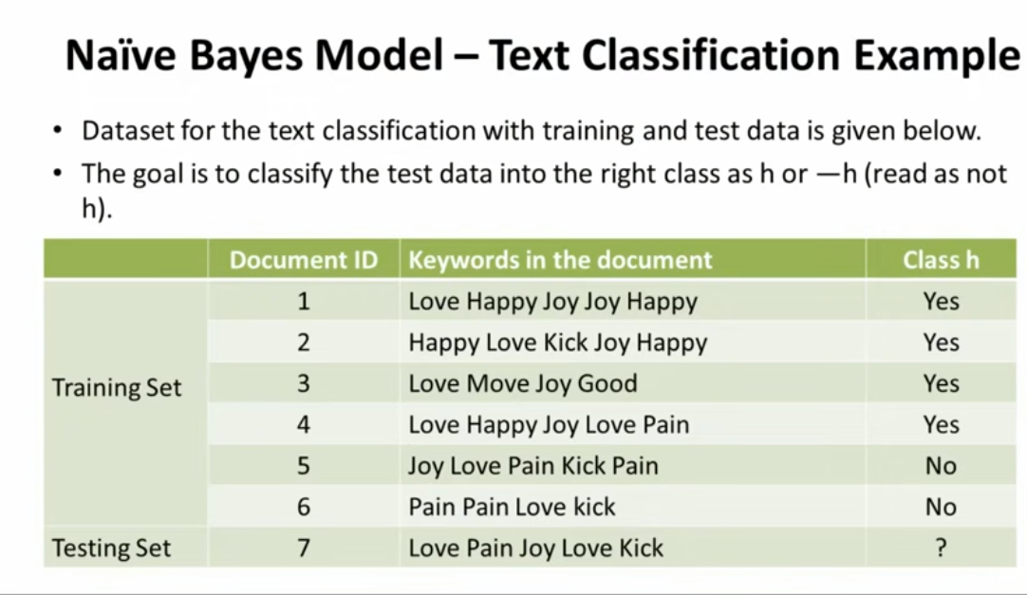

Slide 61
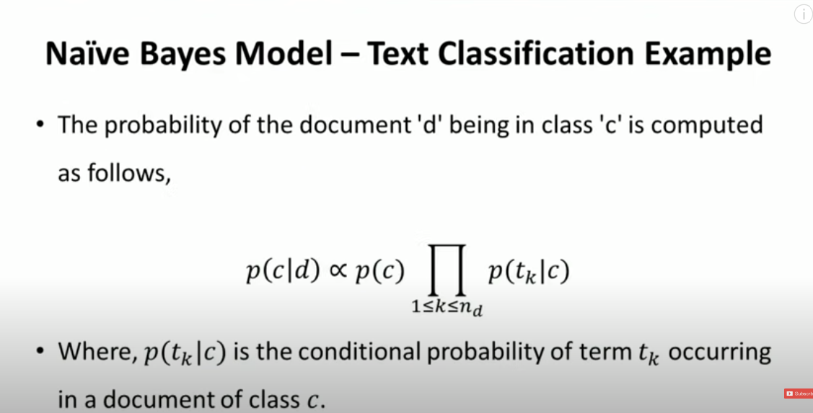

Slide 62
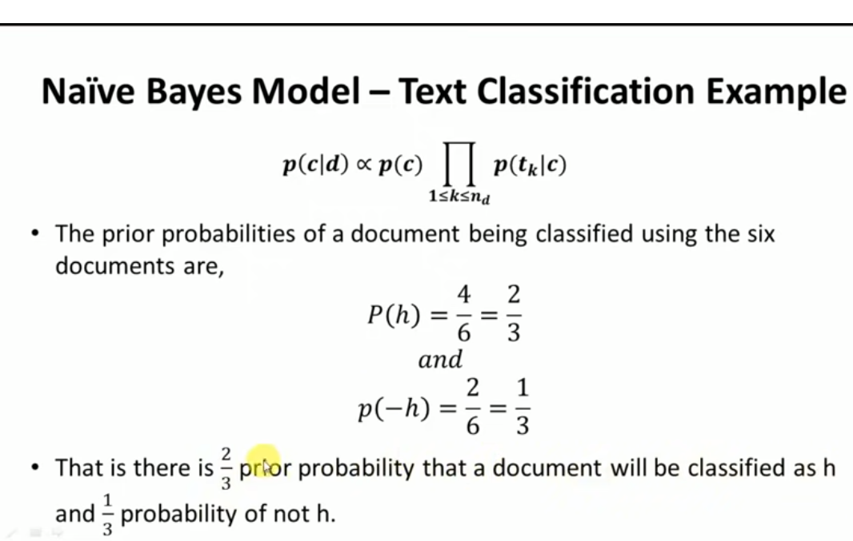

Slide 63
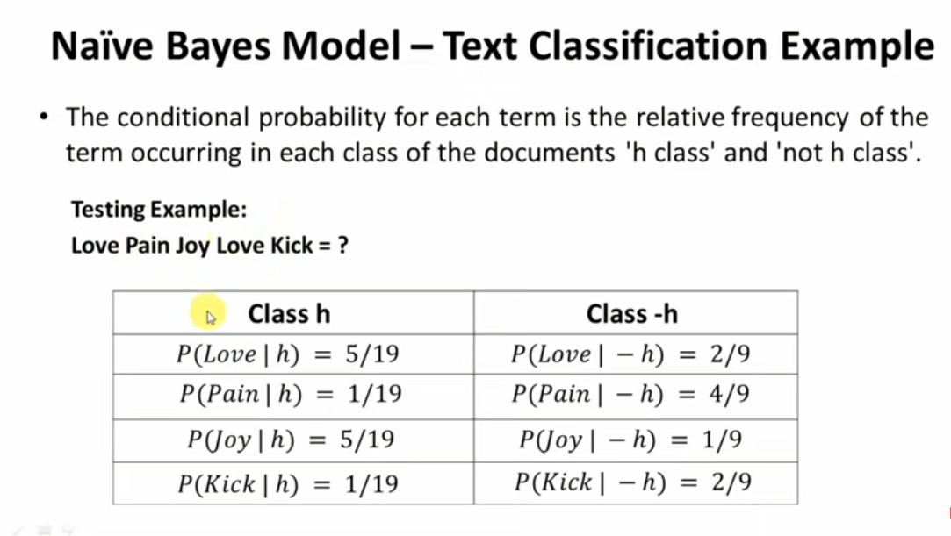

Slide 64
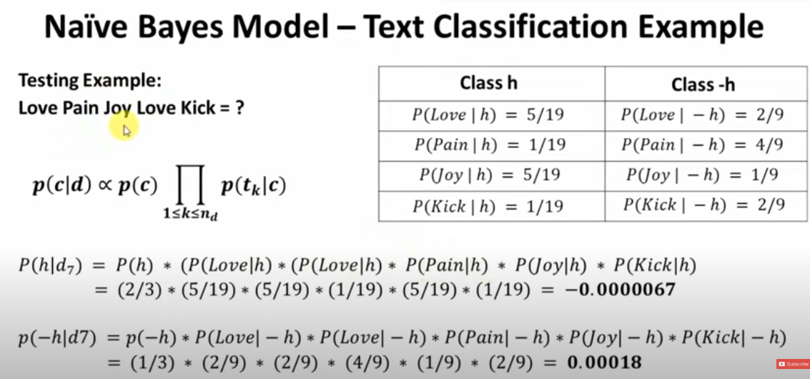

Slide 65
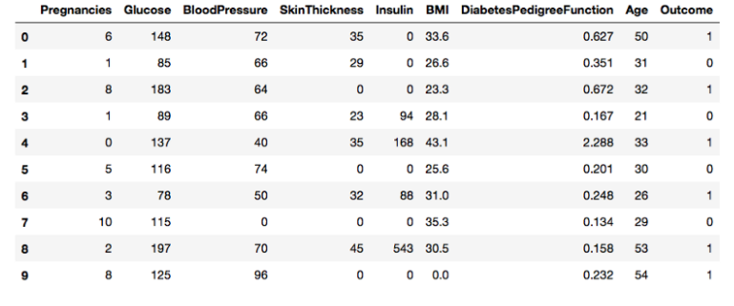
Gaussian Naïve Bayes
Gaussian Naïve Bayes: In Gaussian Naïve Bayes, continuous values associated with each feature are assumed to be distributed according to a Gaussian distribution(Normal distribution). When plotted, it gives a bell-shaped curve which is symmetric about the mean of the feature values.
GaussianNB implements the Gaussian Naive Bayes algorithm for classification. The likelihood of the features is assumed to be Gaussian:

Slide 66
Gaussian Naive Bayes is a classification algorithm that is part of the Naive Bayes family. It assumes that the features follow a Gaussian (normal) distribution and is commonly used for continuous data.
Here's an overview of Gaussian Naive Bayes (GNB):
Key Assumptions:
Naive assumption: All features are independent of each other, given the class label.
Gaussian distribution: For each feature, values in each class are distributed according to a Gaussian distribution.

Slide 67
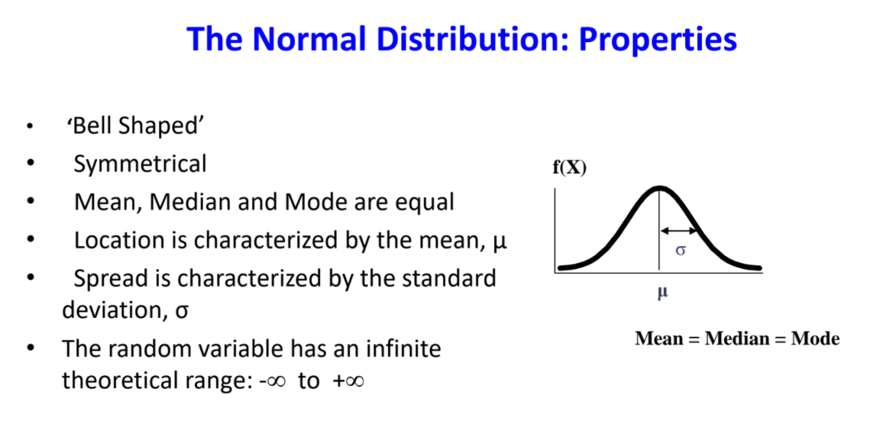

Slide 68


Slide 69


Slide 70
Application of Naive Bayes algorithm
some of the common applications of Naive Bayes for real-life tasks:
Document classification. This algorithm can help you to determine to which category a given document belongs. It can be used to classify texts into different languages, genres, or topics (through the presence of keywords).
Spam filtering. Naive Bayes easily sorts out spam using keywords. For example, in spam, you can see the word ‘viagra’ much more often than in regular mail. The algorithm must be trained to recognize such probabilities and, then, it can efficiently apply them for spam filtering.
Sentiment analysis. Based on what emotions the words in a text express, Naive Bayes can calculate the probability of it being positive or negative. For example, in customer reviews, ‘good’ or ‘inexpensive’ usually mean that the customer is satisfied. However, Naive Bayes is not sensitive to sarcasm.
Image classification. For personal and research purposes, it is easy to build a Naive Bayesian classifier. It can be trained to recognize hand-written digits or put images into categories through supervised machine learning.

Slide 71



Gaussian Naive Bayes Classifier

Slide 72


Slide 73


